Slide 1

Classification Project on Credit Default Prediction
T. Sai Harish Sarma

Slide 2
Contents
Problem Statement
Data Description
Exploratory Data Analysis
Feature Engineering
Modelling, Tuning
Evaluation Metrics
Comparison of Models
Feature Importance
Conclusion

Slide 3
Problem Statement:
This project is aimed at predicting the customer's default payments in Taiwan. From the perspective of the risk management, the result of predictive accuracy of the estimated probability of default will be more valuable than the binary result of classification - credible or non credible clients. We can use the K-S Chart to evaluate which customers will default on their credit card payments.

Slide 4
Data Description
This dataset consists of 30000 rows and 25 columns which contains information on default payments, demographic factors, credit data, history of payment, and bill statements of credit card clients in Taiwan from April 2005 to September 2005.

Slide 5
Data Description
ID: ID of each client
LIMIT_BAL: Amount of given credit in NT dollars (includes individual and family/supplementary credit)
SEX: Gender (1=male, 2=female)
EDUCATION: (1=graduate school, 2=university, 3=high school, 4=others, 5=unknown, 6=unknown)
MARRIAGE: Marital status (1=married, 2=single, 3=others)
AGE: Age in years
PAY_0: Repayment status in September, 2005 (-2= No Consumption, -1=pay duly, 0= paid minimum & revolving credit, 1=payment delay for one month, 2=payment delay for two months, … 9=payment delay for nine months and above)
PAY_2: Repayment status in August, 2005 (scale same as above)
PAY_3: Repayment status in July, 2005 (scale same as above)
PAY_4: Repayment status in June, 2005 (scale same as above)
PAY_5: Repayment status in May, 2005 (scale same as above)
PAY_6: Repayment status in April, 2005 (scale same as above)

Slide 6
Data Description
BILL_AMT1: Amount of bill statement in September, 2005 (NT dollar)
BILL_AMT2: Amount of bill statement in August, 2005 (NT dollar)
BILL_AMT3: Amount of bill statement in July, 2005 (NT dollar)
BILL_AMT4: Amount of bill statement in June, 2005 (NT dollar)
BILL_AMT5: Amount of bill statement in May, 2005 (NT dollar)
BILL_AMT6: Amount of bill statement in April, 2005 (NT dollar)
PAY_AMT1: Amount of previous payment in September, 2005 (NT dollar)
PAY_AMT2: Amount of previous payment in August, 2005 (NT dollar)
PAY_AMT3: Amount of previous payment in July, 2005 (NT dollar)
PAY_AMT4: Amount of previous payment in June, 2005 (NT dollar)
PAY_AMT5: Amount of previous payment in May, 2005 (NT dollar)
PAY_AMT6: Amount of previous payment in April, 2005 (NT dollar)
default.payment.next.month: Default payment (1=yes, 0=no)

Slide 7
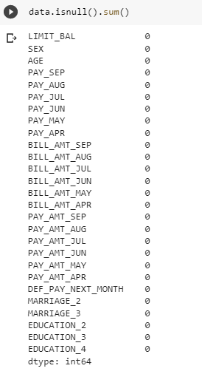

Data Description

Slide 8
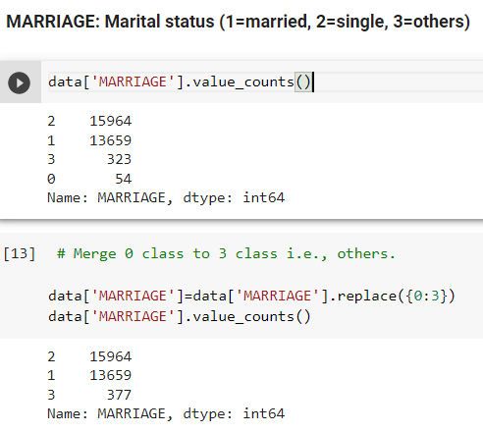
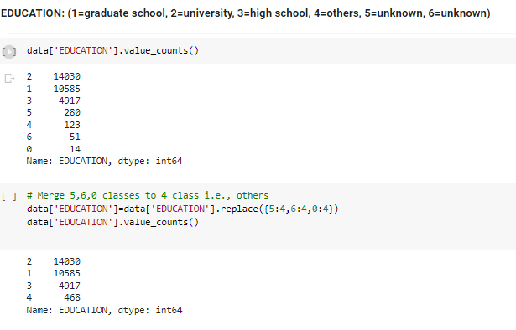
Data Handling

Slide 9
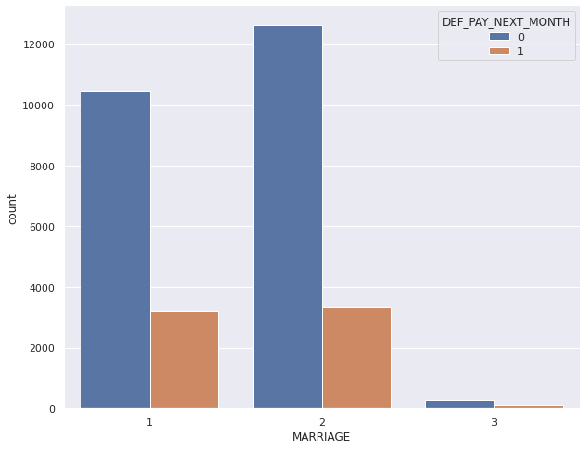
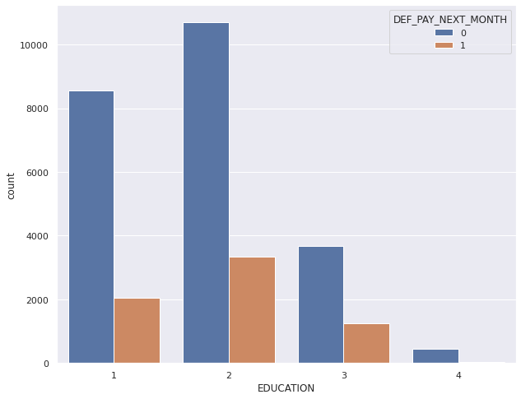
Exploratory Data Analysis
MARRIAGE: Marital status (1=married, 2=single, 3=others)
EDUCATION: (1=graduate school, 2=university, 3=high school, 4=others)

Slide 10
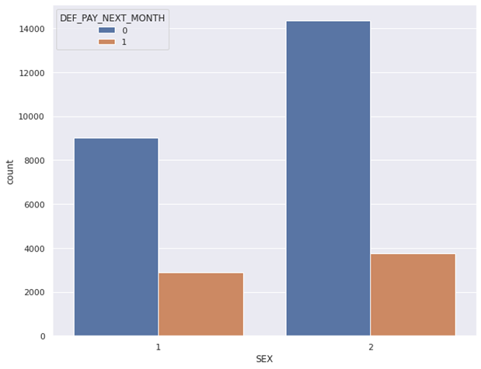
Exploratory Data Analysis
SEX: Gender (1=male, 2=female)
Female = 18112
Male = 11888
Female count is higher than Male in –
taking credit card.

Slide 11
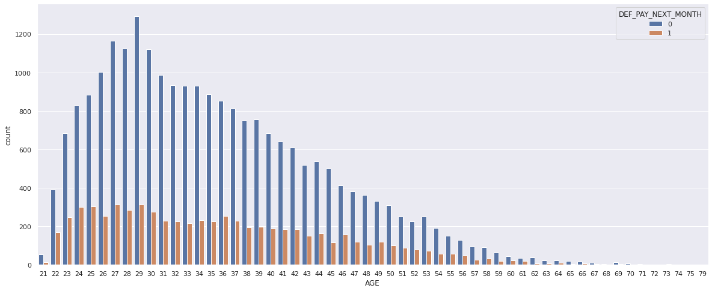
Exploratory Data Analysis

Slide 12
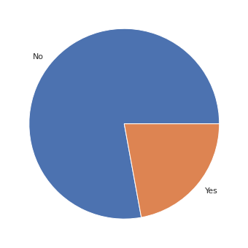
Exploratory Data Analysis
77.88 % people are not the defaulters of credit card. 22.12 % (6636 out of 30000) people are the defaulters.
23364
6636

Slide 13
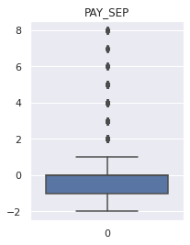
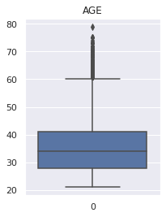
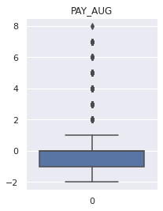
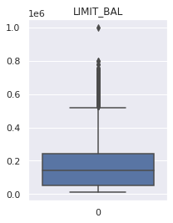

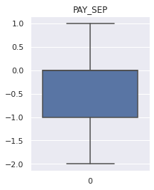
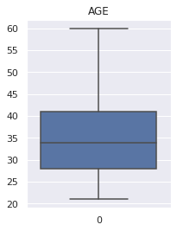

Handling Outliers
Using Z Score

Slide 14
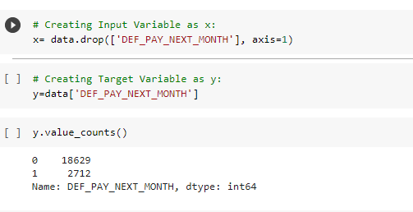
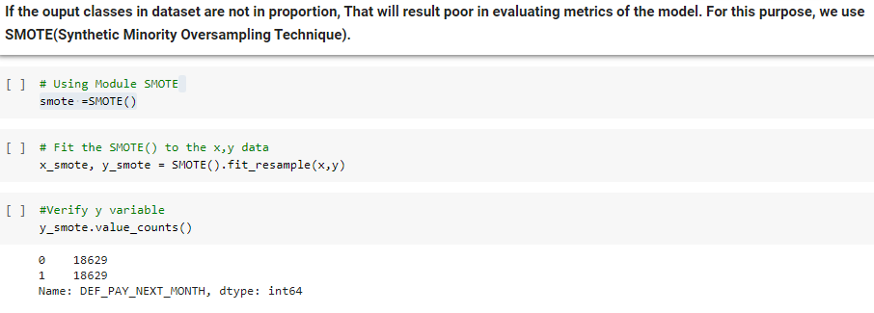
Handling Imbalance of Data

Slide 15
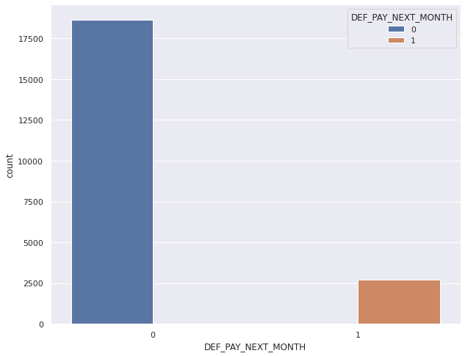
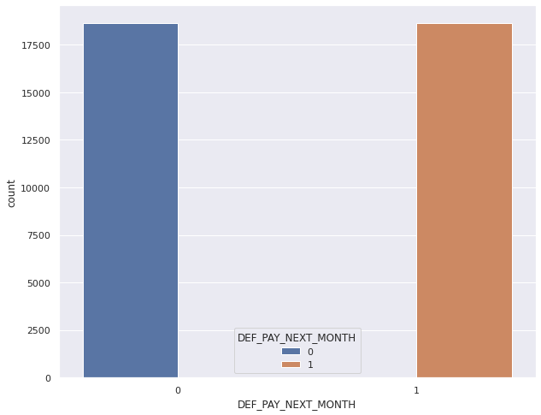

Handling Imbalance of Data

Slide 16
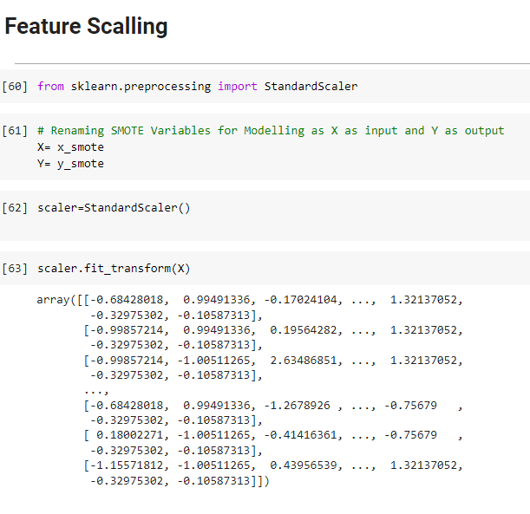
Feature Scaling

Slide 17
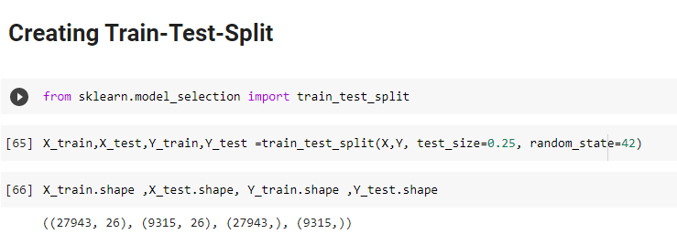
Creating Training and Testing Data Set

Slide 18
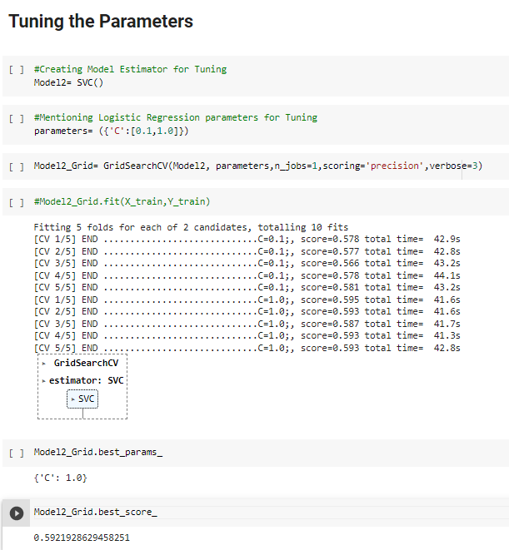
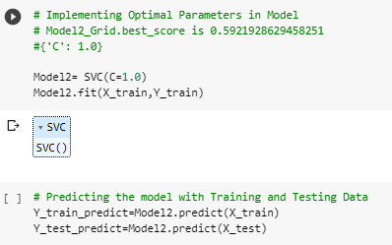
Parameter Tuning & Implementation

Slide 19
Model Evaluation Metrics
Train Accuracy
Test Accuracy
Recall Score
Precision Score
AUC ROC Score
F1 Score

Slide 20
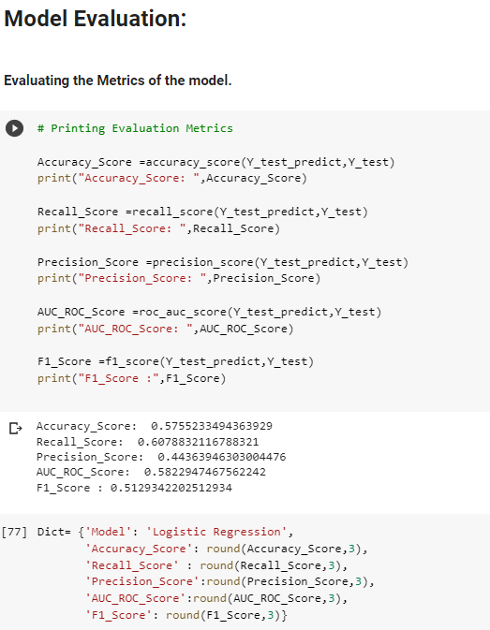
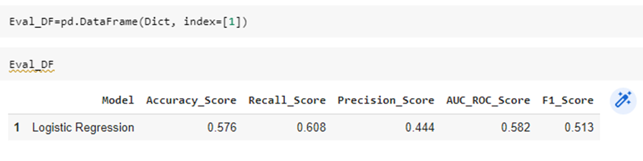
Model Evaluation Metrics

Slide 21
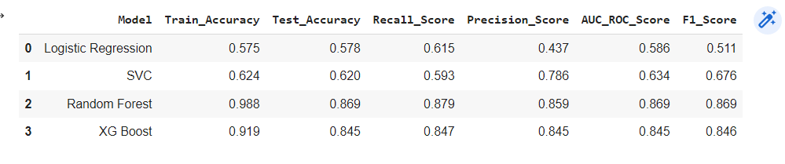
Comparing Metrics

Slide 22
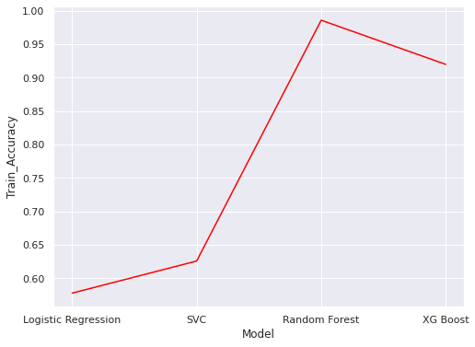
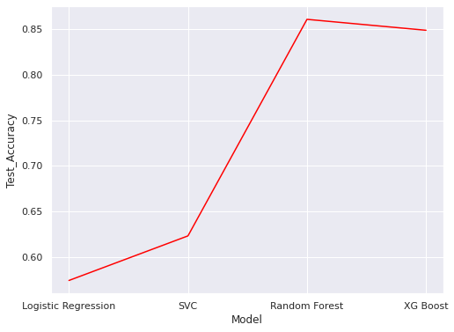
Comparing Metrics

Slide 23
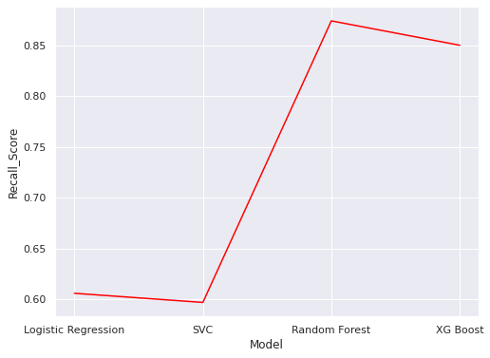
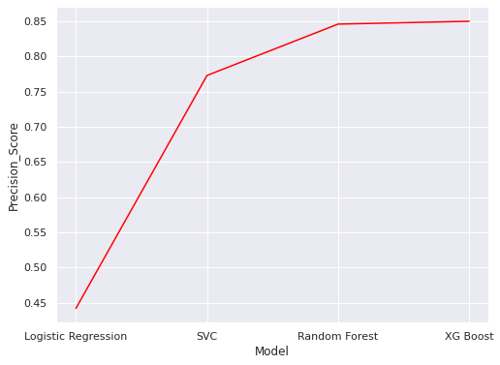
Comparing Metrics

Slide 24
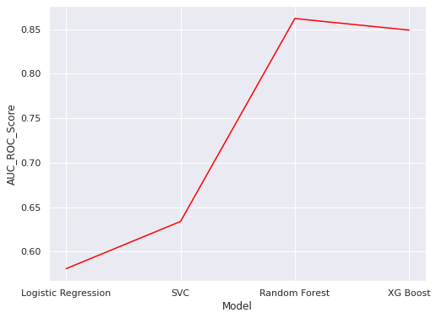
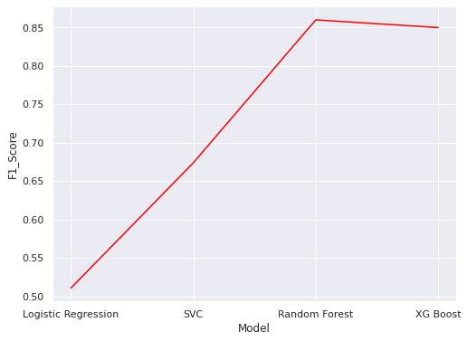
Comparing Metrics

Slide 25
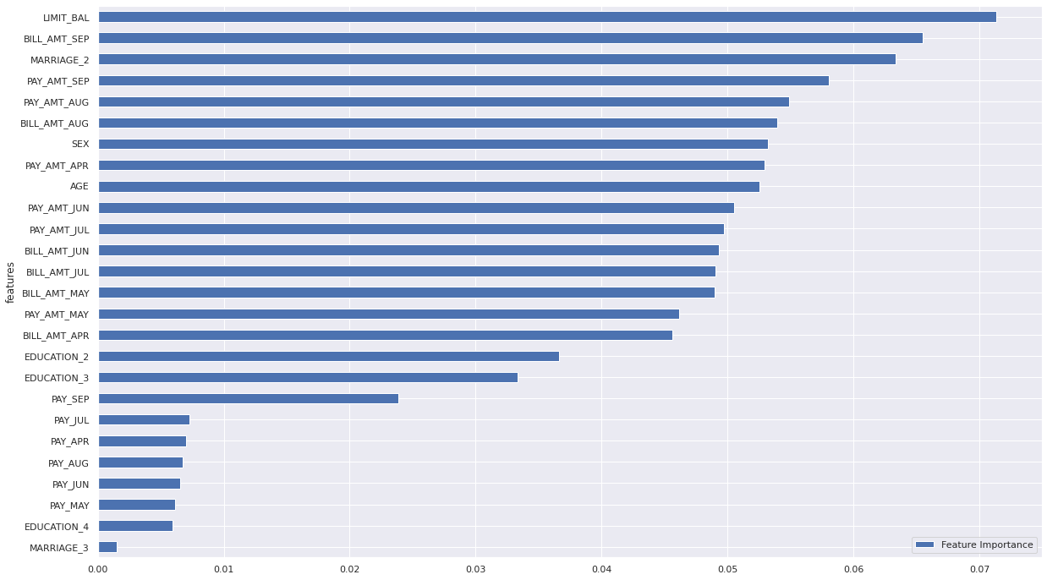
Feature Importance – Random Forest

Slide 26
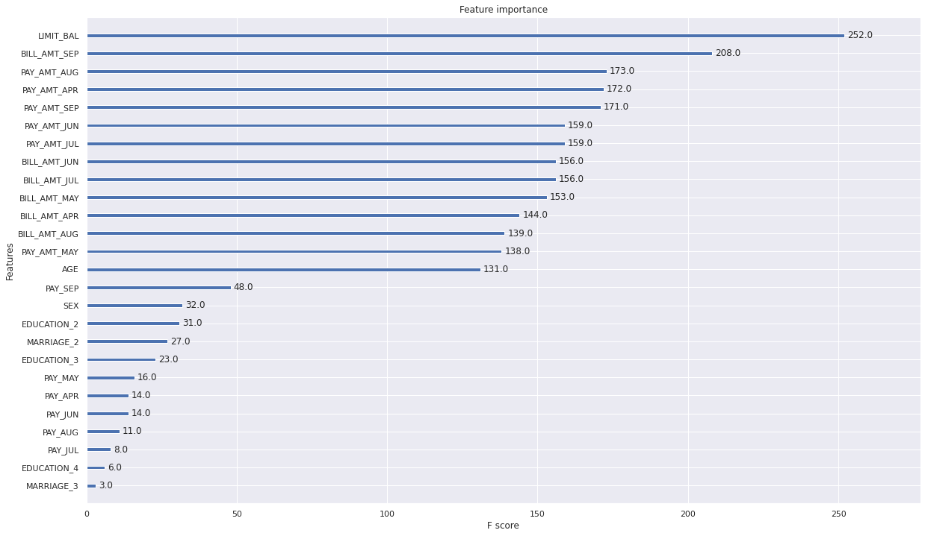
Feature Importance – XG Boost

Slide 27
Conclusion
EDA Outcomes:
People who are not married taking credits slightly higher than the married people
Age of most using og credit is in the range of 24 and 40. After the age 60, almost there is a declinebusing credit.
77.88 % people are not the defaulters of credit card. 22.12 % (6636 out of 30000) people are the defaulters.
Female count is higher than Male in taking credit card.
Challenges:
Outliers detected by Boxplot and Treated
Imbalance of Data treated by SMOTE Approach
Some Data not having proper explanation
Removed Irrelavent classes in columns.

Slide 28
Conclusion
Model Outcomes:
Among all the models, Random Forest Model given good results.
Random Forest Classifier & XG Boost given the best precision Score i.e. 85.9% & 84.5% respectively.
Random Forest Classifier given the best recall Score i.e. 87.9%
The Columns 'LIMIT_BAL','BILL_AMT_SEP' & 'PAY_AMT_AUG' are the most important features for our Target Feature i.e., to check whether the user Defaulter or not.
In Overall, Random Forest Classifier best to fit on this data, But Execution of CrossValidation using GridSearchCV for hyper parameters takes long time.

Slide 29
Thank you

